Slide 1
Task 2: Predicting customer buying behaviour

Slide 2
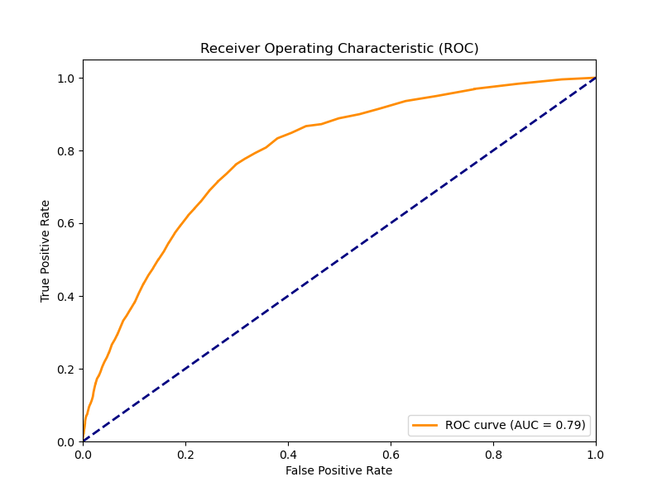
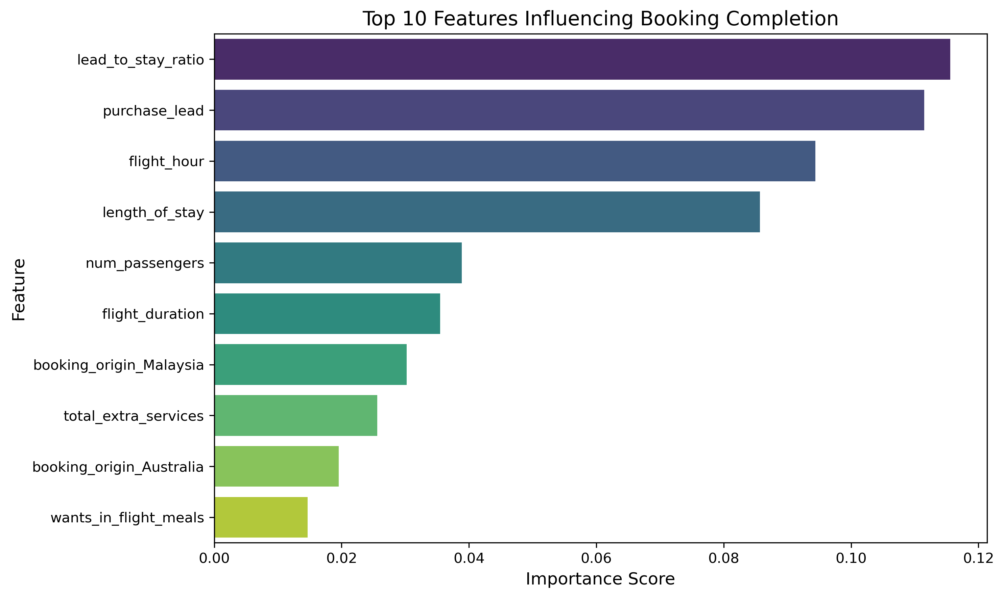
Key Findings
• The Random Forest model achieved an accuracy of approximately 85.24% on the test set.
• Top predictors of booking completion were: purchase_lead, total_extra_services, sales_channel_Internet,
wants_extra_baggage.
• Cross-validation scores averaged 75.28% indicating consistent performance across data splits.
• Customers who requested more add-ons (baggage, meals, seat) were more likely to complete bookings.
• Personalizing offers based on these factors could improve conversion rates.

